Slide 2

One of Sweden’s youngest higher education institutions
  Located in Kalmar and Växjö
  About 35,800 students
  About 15,600 full-time equivalents
  About 2,100 employees

Slide 3
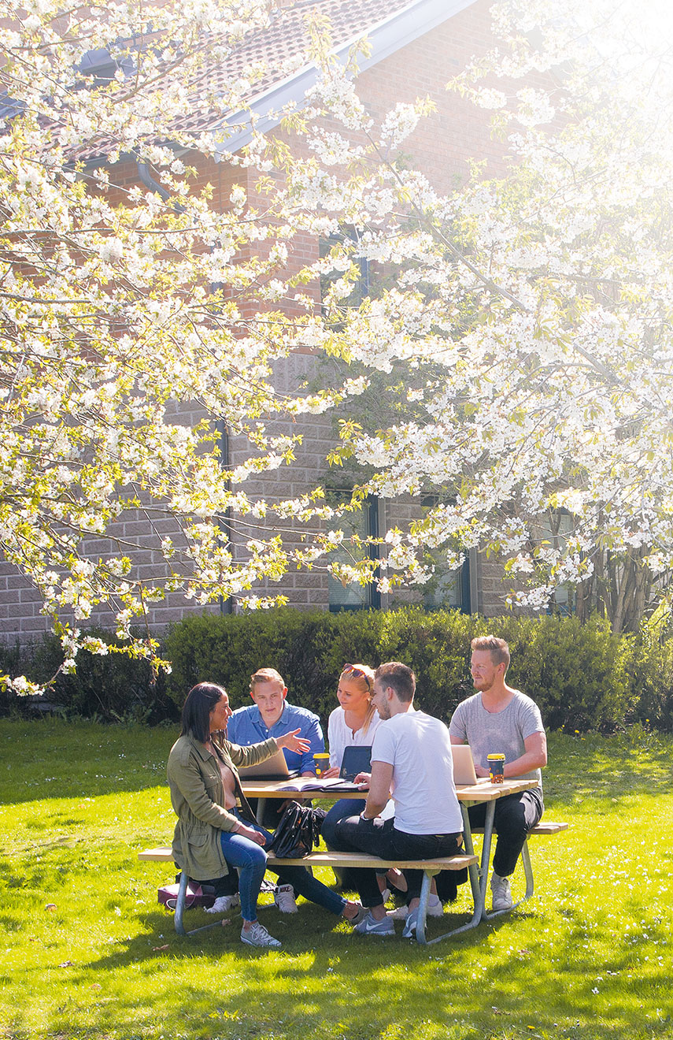
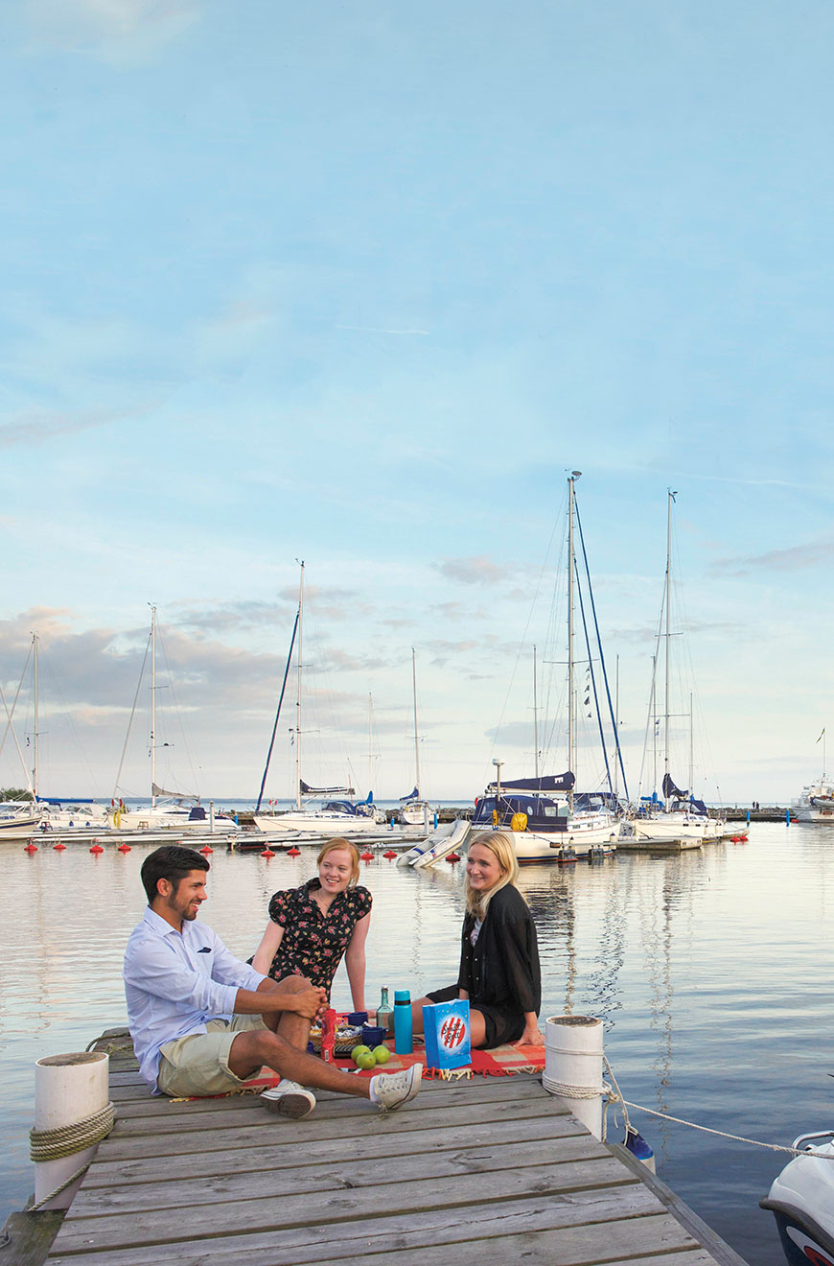
An attractive campus area and a city-integrated university

Slide 4
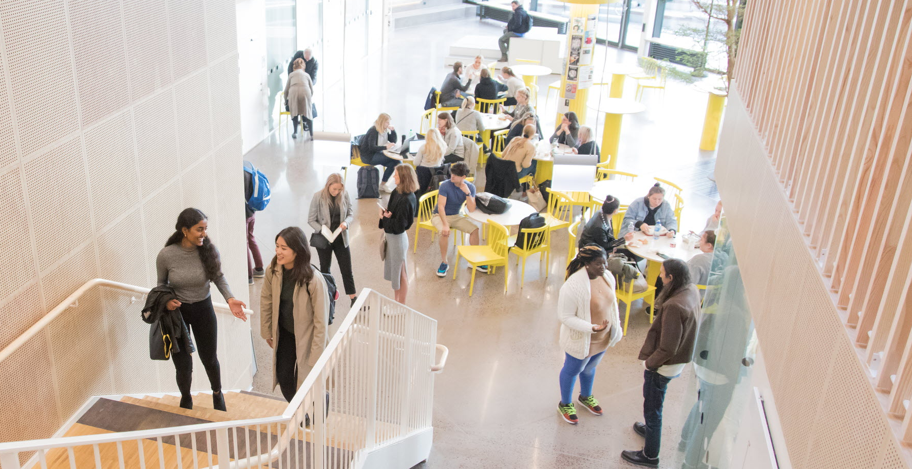
In Linnaeus’s spirit
  Curiosity | Creativity | Companionship | Utility

Slide 5

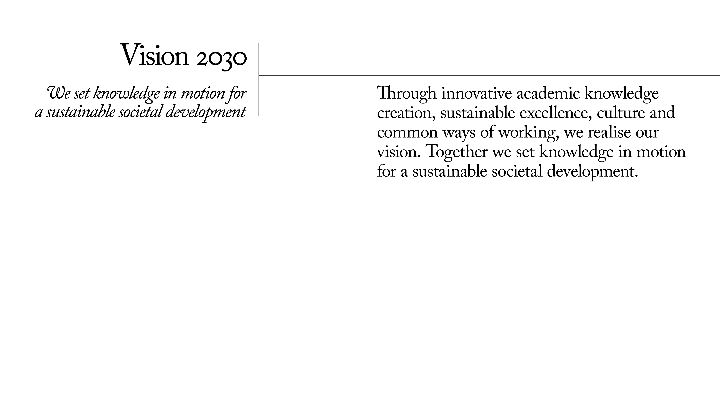
Notes:
In order to set knowledge in motion for a sustainable societal development the following is required:
Innovative academic knowledge creation
Linnaeus University wants to make the most of and strengthen the creativity that is generated in knowledge environments that integrate scientific and artistic research, challenging educations, and innovative collaboration. We achieve this by developing an open, critical, and cross-boundary knowledge creation with and for people and society.
Sustainable excellence
We profile ourselves by developing our ability to convey and utilise knowledge that significantly and consistently contributes to a sustainable societal development. Academic freedom and excellence form the basis for a legitimate and powerful societal relevance. Free and independent research is the university’s contribution to innovative excellence that guarantees a sustainable knowledge creation.
Culture and common ways of working
The Linnaeus spirit mirrors the academic community’s reflecting, critical, and creative societal role. The work is based on respectful collaboration and a comprehensive view of the university’s operations.

Slide 6
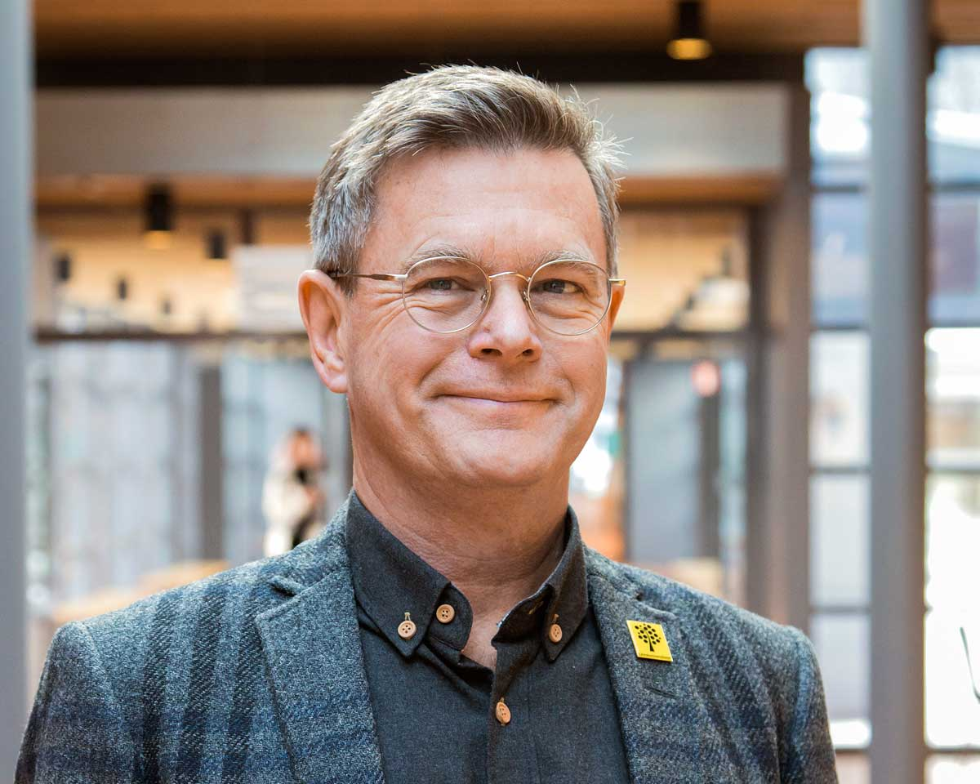
Organisation
University Administration
Communications Office
Executive Office
Finance Office
Linnaeus University’s vice-chancellor is Peter Aronsson, professor of history.
Faculty of Social Sciences
Faculty of Technology
IT Office
Office of External Relations
Office of Facilities Management and Services
Faculty of Health and Life Sciences
School of Business and Economics
Office of Human Resources
Office of Student Affairs
University Library
Board of Teacher Education
Faculty of Arts and Humanities

Slide 7
Education and research at Linnaeus University ⁽²⁰¹⁹⁾
Research/education at third-cycle level
^{Contract education}
Education at first-cycle/second-cycle level

Slide 8
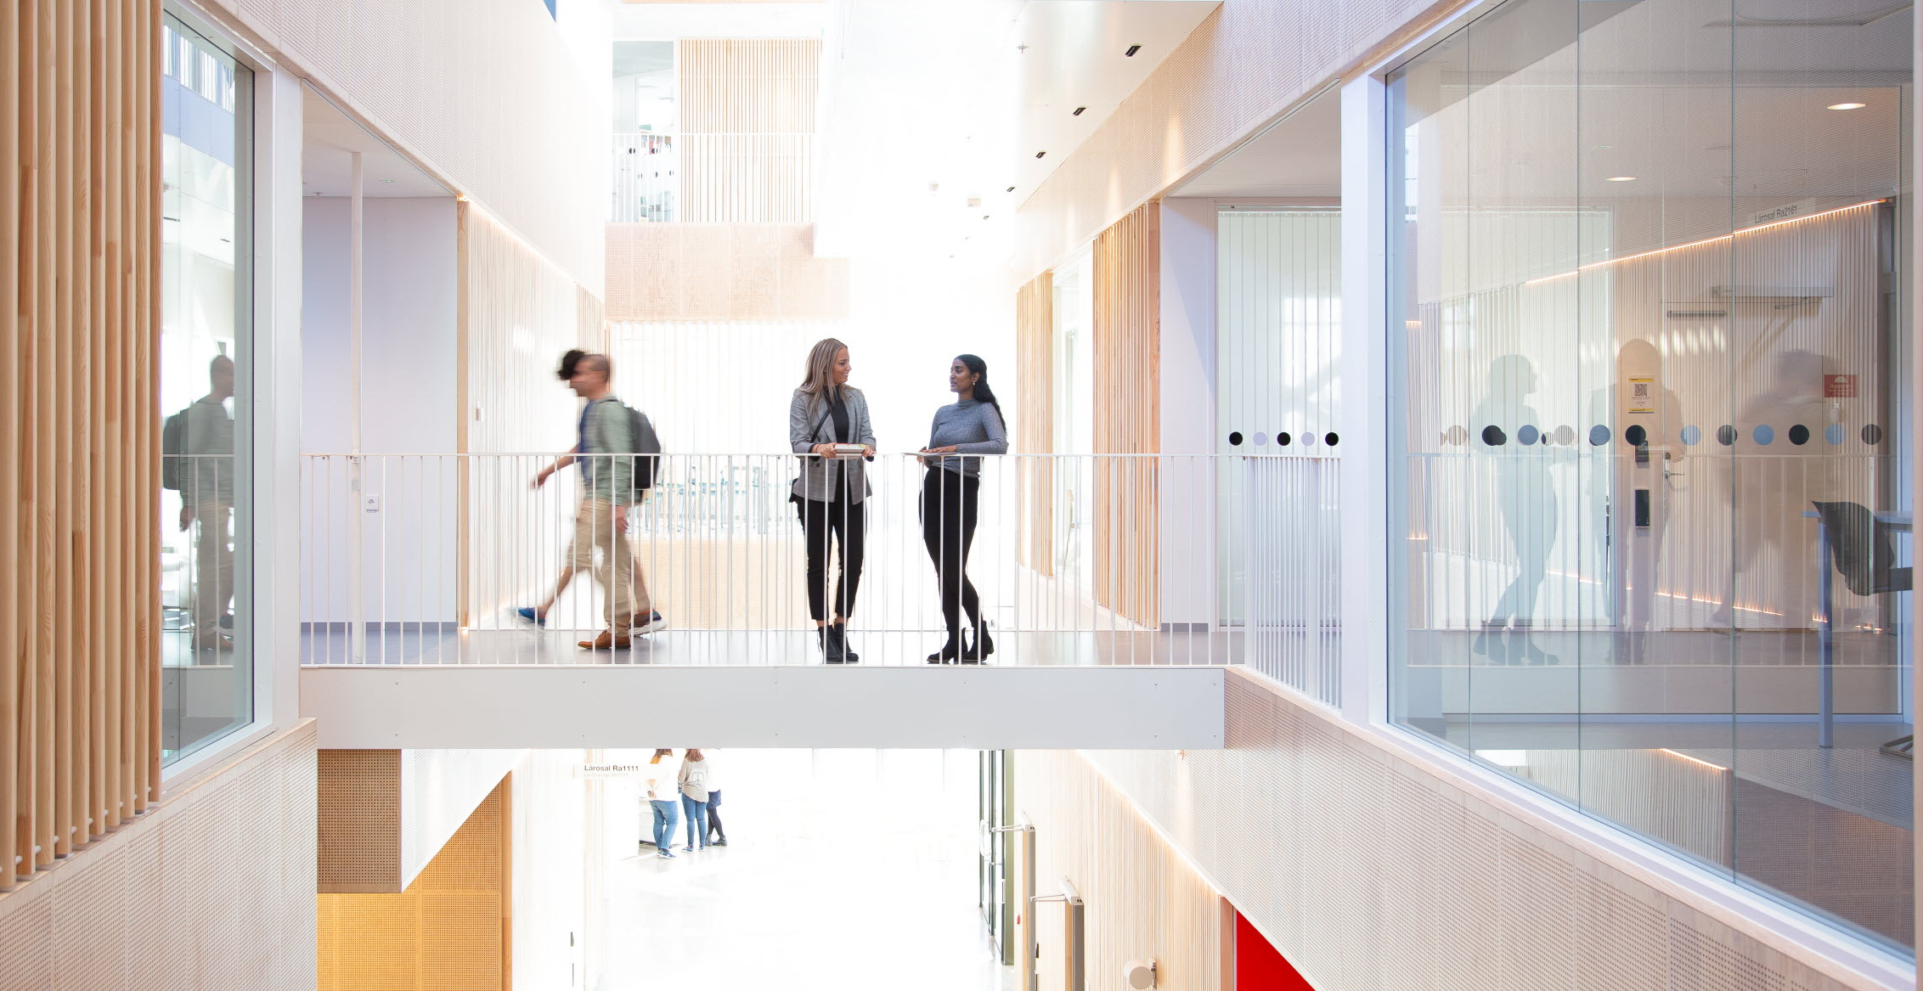
Top five…
  …applicants to degree programmes
  Management and organisation, 599
  Web development, 360
  Nursing, 347
  Social work, 276
  Psychologist, 266
  …applicants to single-subject courses
  Psychology I, 457
  Social law, 457
  Project management I, 376
  Sustainable small-scale forestry I, 247
  Food, nutrition and health, 235
(number of first-choice applicants)

Slide 9

Master of science in engineering
  In autumn 2020, a master of science in engineering with specialisation in software engineering will start

Slide 10

Prominent research
  Nationally and internationally prominent research
  About 160 professors
  About 310 doctoral students
  Six cutting-edge research groups – Linnaeus University Centres

Slide 11




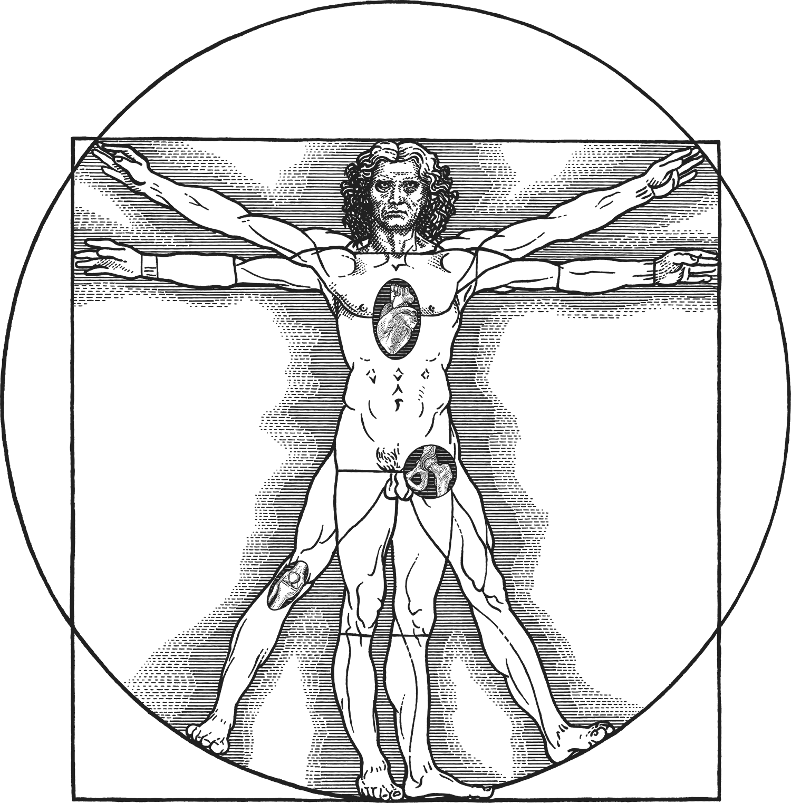
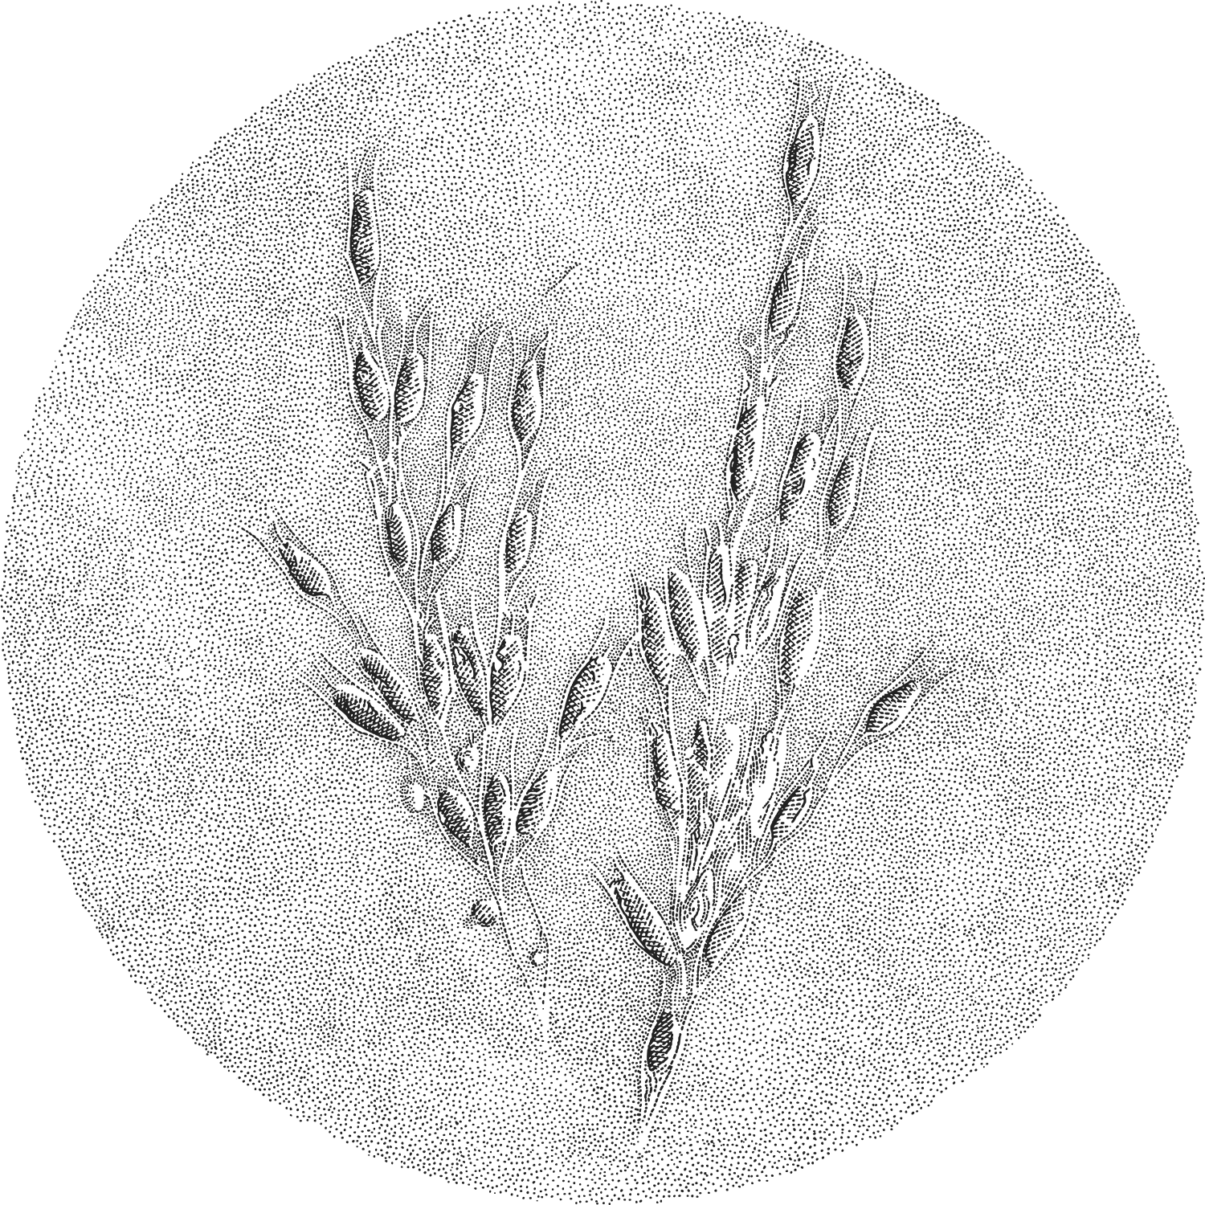
Linnaeus University’s
cutting-edge research
  Cultural encounters as a consequence of colonial expansion
  Intermedial and multimodal theories and research methods
  Collection, analysis and utilisation of large quantities of data
  Discrimination and integration
  Biomaterials chemistry
  Ecology and evolution

Slide 12

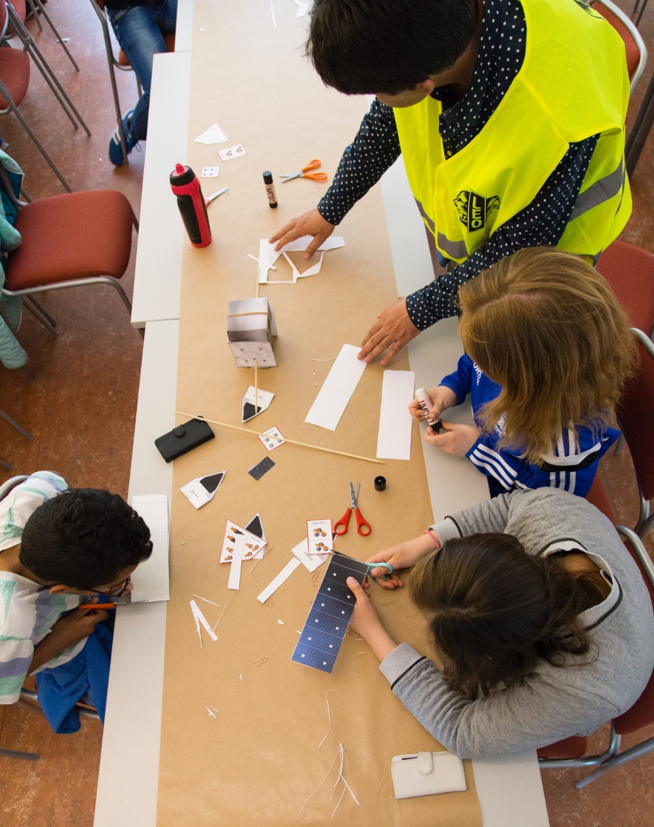

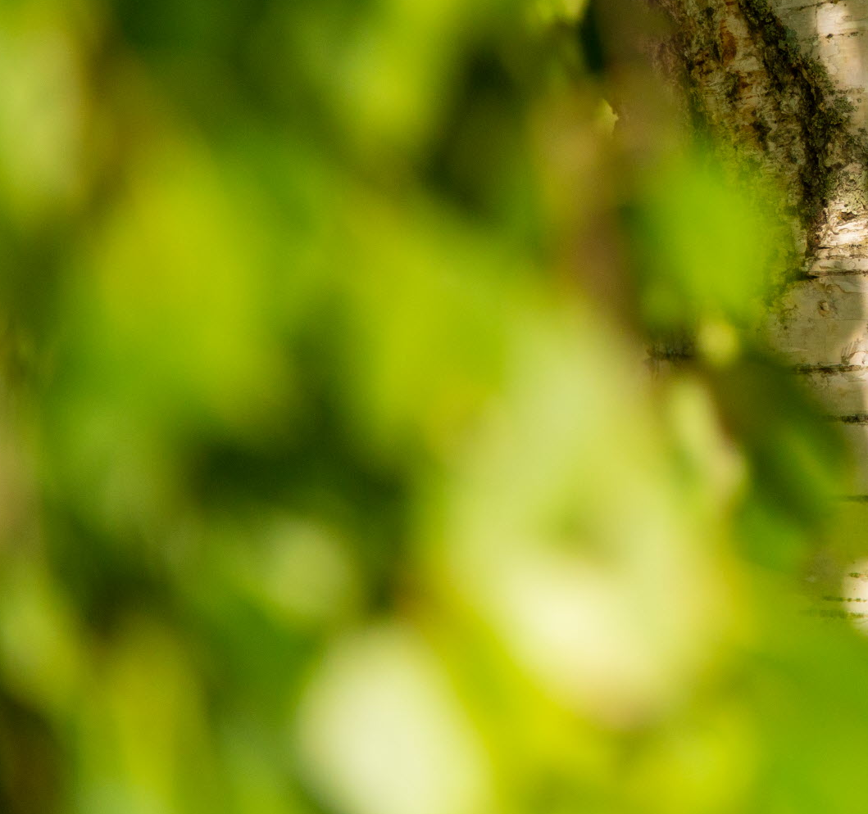



Linnaeus knowledge environment
  A questioned democracy
  Education in change
  Advanced materials
  Green sustainable development
  Water
  Sustainable health
  Digital transformations

Slide 13
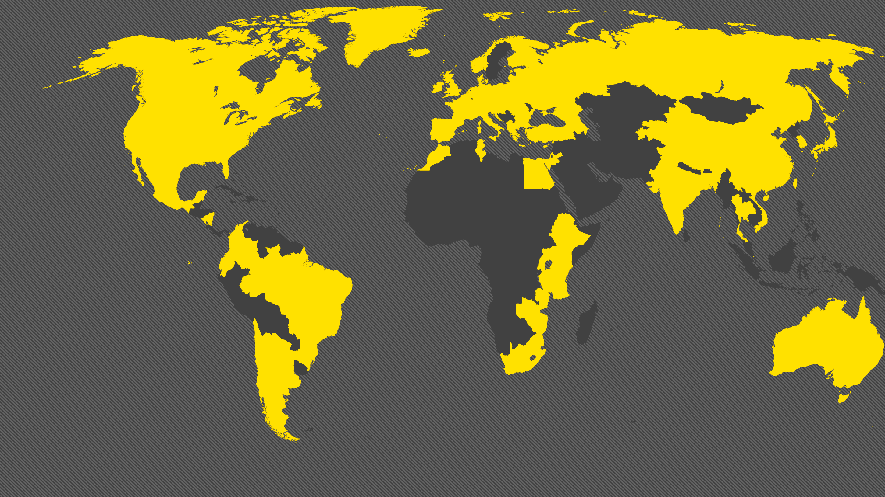
Linnaeus University in the world
  About 730 incoming international students every year
  About 300 outgoing exchange students every year
  About 780 partner universities in more than 80 countries
  Exchange opportunities for doctoral students, researchers/teachers and administrative staff

